Slide 1
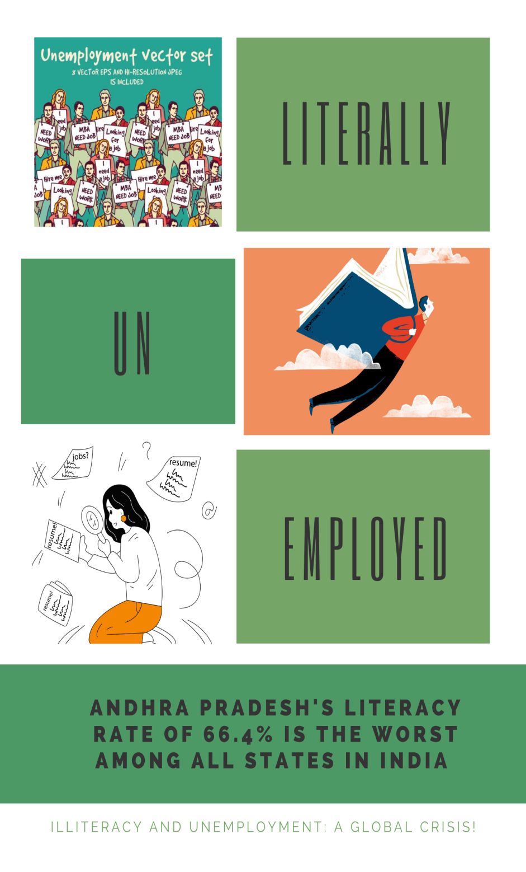
nugget
Insight: people are not satisfied with the literacy rate and employment.
Evidence: I saw people with good degree but unemployed
I heard people are not getting chance of entrepreneurship.
Movie title : Literally Unemployed
Poster: more number of graduates are unemployed.

